Slide 1


Part 5: Continuing to Continue
Contents
I. Tragedy Strikes
II. Redemption and Protection
III. RGB LEDs
IV. JSCH Java SSH Protocol
V. Bringing it All Together

Slide 2
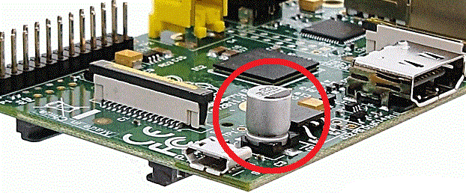
Tragedy Strikes
The C6 capacitor on the Raspberry Pi is susceptible to breakage with very little force applied.
I found this out the hard way.
After bringing my Pi to class, I realized the capacitor had broken off and was rolling around in my toolbox.
Heartbroken, I took to the internet to find a solution to my potentially $35 dollar mishap.
It turns out this is a very common occurrence and is, in fact, not a serious issue.
The C6 capacitor is in place to act as a filter from the power source to the board.
Most (if not all) power sources have built-in measures to accomplish the same thing the C6 capacitor is there for.

Slide 3
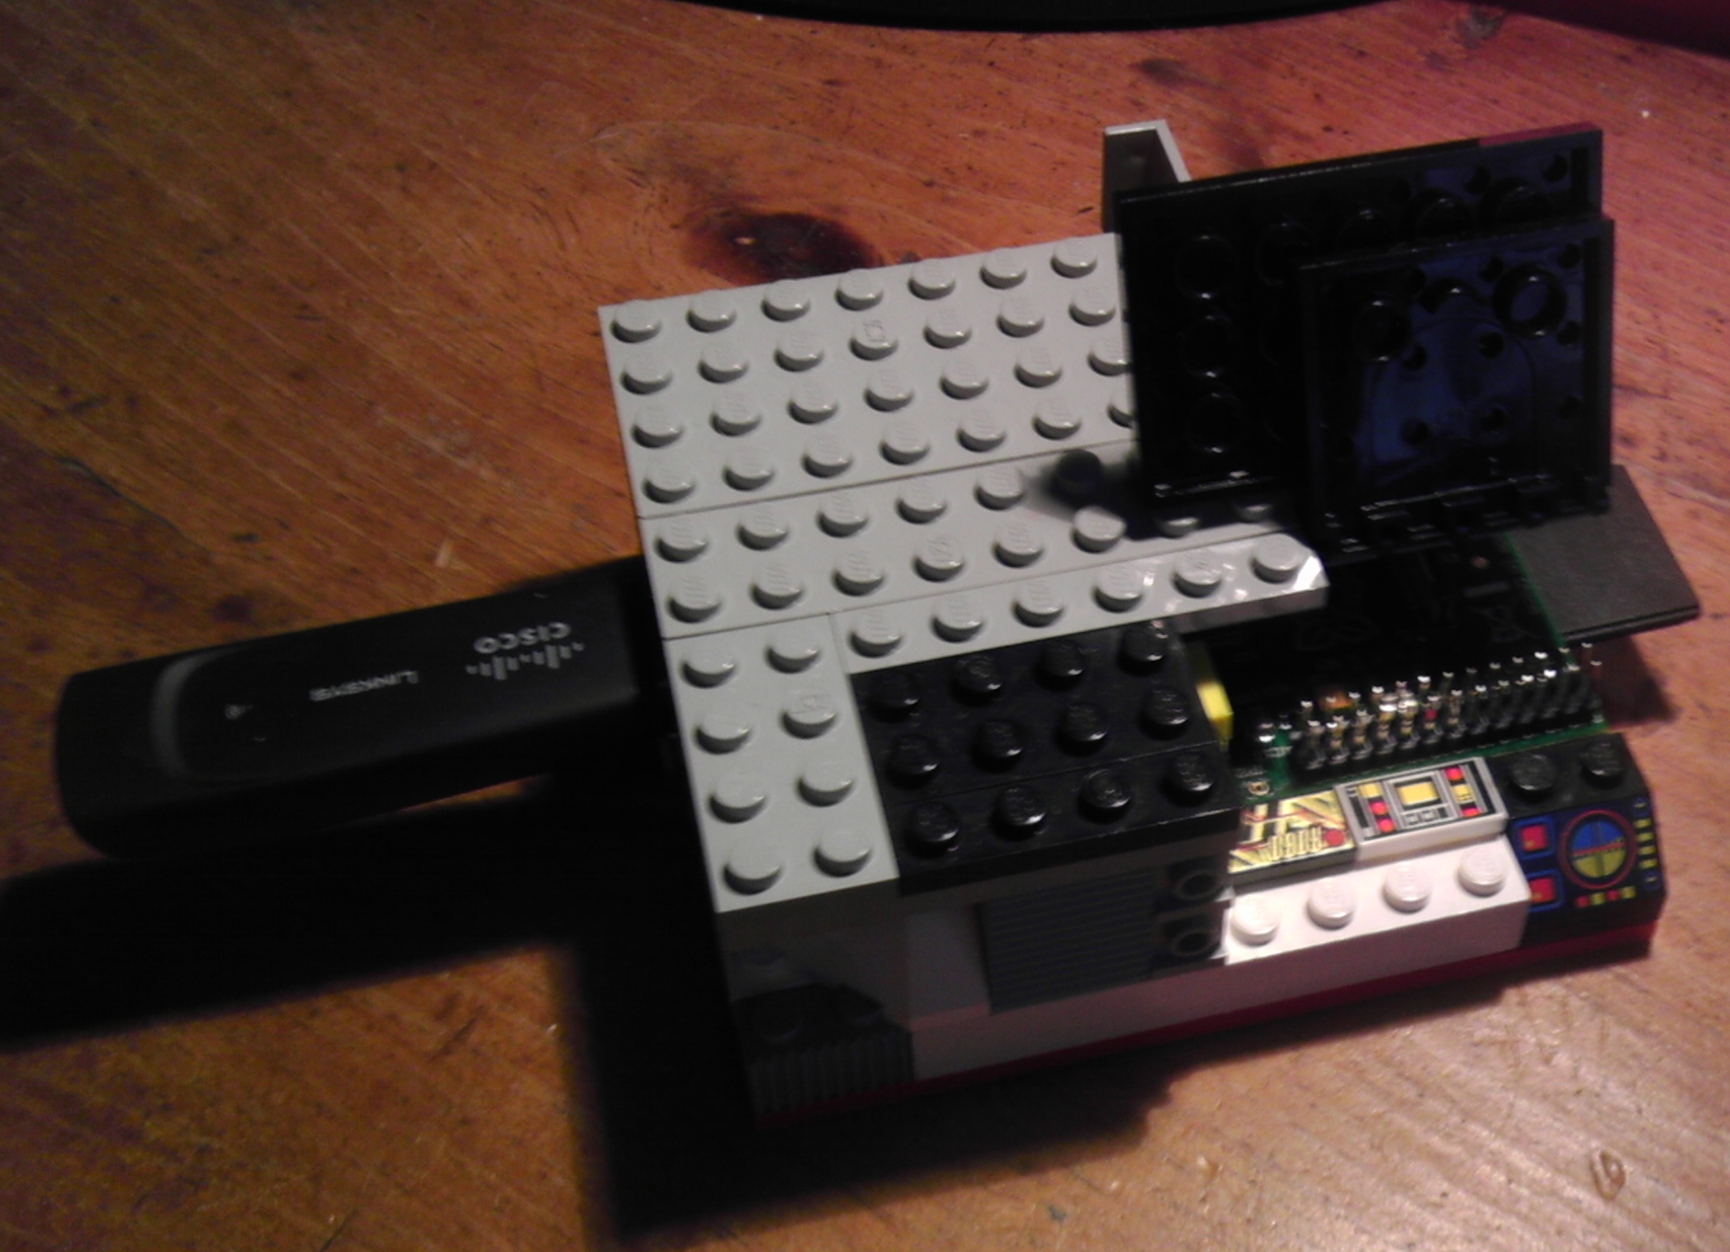
Redemption and Protection
Rather than simply live with a broken Pi in the naïve belief that nothing could go wrong because someone on the internet said so, I set out to repair the problem myself.
Using my admittedly weak soldering skills, I was able to reattach the capacitor. I then decided to ensure nothing like this could happen again. So I got out my Legos.
Using random bits and pieces from my decades-old collection of Legos, I built a stylish and functional case for my Raspberry Pi.

Slide 4
RGB LEDs
My original intention for this project was to control an RGB LED that could change colors.
I put in an order and received a pack of 12 LEDs and set about working with them.
They are quite simple to work with and required minimal changes to my code for standard LEDs.
An RGB LED has 4 leads, 1 for each color(red, green, and blue) and 1 for the common anode. Each color requires a different voltage to operate, so I utilized three resistors to control said voltage.

Slide 5
JSCh SSH Protocol
Throughout the process of working on this project, I've been looking for an easy way to SSH into my Pi from a Java program.
For awhile, it was a grim process, with the process becoming more and more convoluted by the day.
I finally found a Java package called JSCh which allows for easy SSH access through Java.
It works very similarly to Putty, and with a few modifications to the code, I was able to automatically log into my Pi through SSH from my Java program.
This allows the SSH protocol to seamlessly integrate with my Leap controller program.

Slide 6
Bringing it All Together
I've written a C program on the Pi (using wiringPi) that has complete control over an RGB LED. The functions include turning the LED on and off, changing between 1 of about 6 colors, and dimming the LED(for every color) using pulse width modulation.
On the PC side, I've got a Java program that automatically SSH's into my Pi and can accept gestures from the Leap Motion.
The next - and hopefully final – step is to use gestures to send customized outputs to the Pi running my C program.

